Slide 1
Biology
Unit 7: Genetics and Heredity
Lesson 5: Genetic Engineering
Notes:
Lesson Objective:
Ask questions and explore benefits and risks of genetic testing, cloning and genetic engineering.

Slide 2

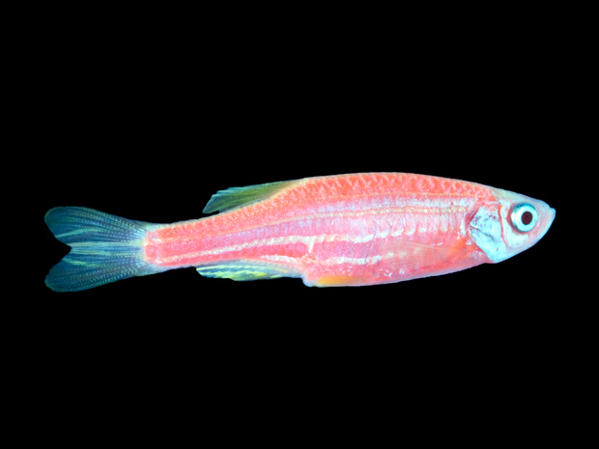
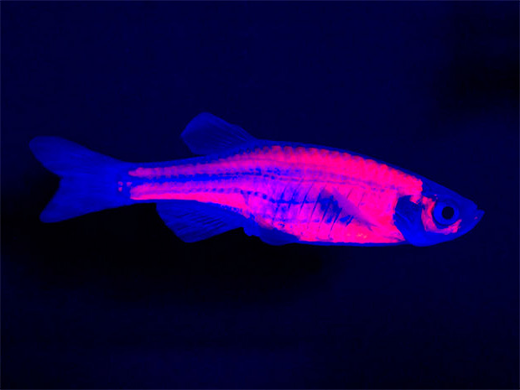
Can You Explain It?
Unit 7 Lesson 5
What does it means to change the genome of an organism? Is this fluorescent zebrafish a new type of animal?
Notes:
Lesson Objective Use models to draw conclusions about the properties of atoms, ions, and molecules and the breaking and forming of bonds between these particles in chemical reactions.

Slide 3
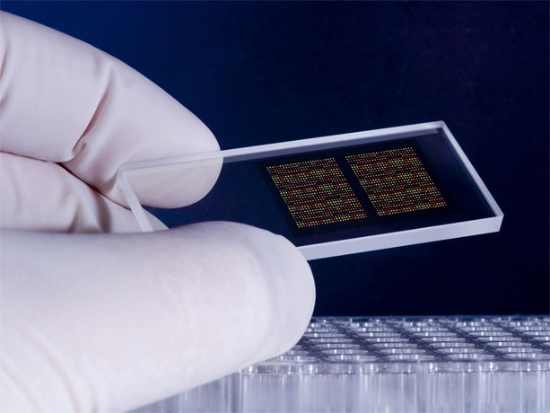
Isolating Genes
Unit 7 Lesson 5
Genetic testing is the analysis of a person's DNA to determine the risk of having or passing on a genetic disorder.
Geneticists test for abnormalities in genetic material, from entire chromosomes down to individual genes.
The invention of the polymerase chain reaction (PCR) was a turning point, making it possible to obtain the large amounts of DNA needed for genetic testing in hours instead of days.

Slide 4
The Polymerase Chain Reaction Patterns
Unit 7 Lesson 5
DNA replication produces a complementary strand of DNA, while PCR amplifies a target section of DNA by copying just that section. How else are DNA replication and PCR similar? How are they different?

Slide 5
The Polymerase Chain Reaction
Unit 7 Lesson 5
EXPLAIN
Describe the relationship between genetic testing and the polymerase chain reaction. How has the PCR technique made genetic testing possible on a large scale?

Slide 6
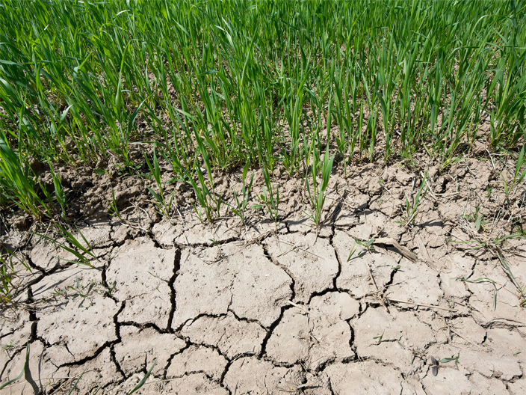
Cloning and Engineering
Unit 7 Lesson 5
Long periods of drought in many areas of the world threaten food production because many commercial crops are not adapted to dry climates.
Make a list of possible criteria for evaluating drought-resistant crops along with the other solutions.

Slide 7

Cloning and Engineering
Unit 7 Lesson 5
Many plants produce genetically identical offspring, or clones, through asexual reproduction.
Some plants, such as spider plants, produce "pups," or genetically identical offspring.

Slide 8
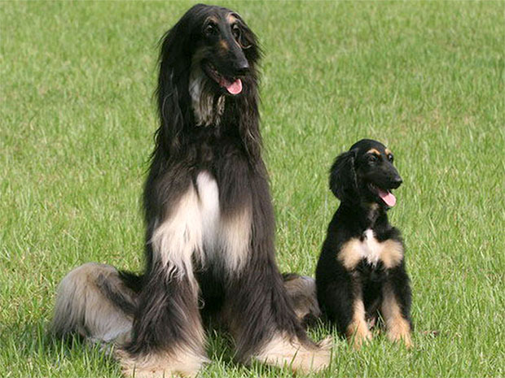
Cloning and Engineering
Unit 7 Lesson 5
Several companies offer pet cloning services that will produce an exact genetic copy of a pet.
Why is a clone not an exact copy of the donor animal?

Slide 9
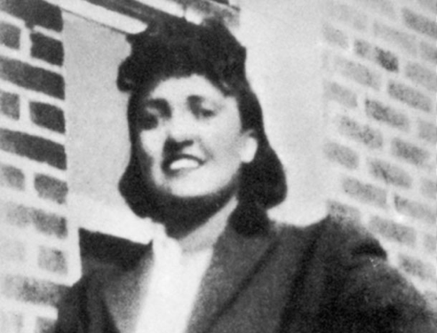
Cloning and Engineering
Unit 7 Lesson 5
Henrietta Lacks died of cervical cancer in 1951. Before she died, a researcher took a sample of her tumor. From this sample, scientists made the first "immortal" cell line, named
Unlike other cells, HeLa cells did not die when cultured in the lab. From the polio vaccine and cloning to AIDS research and experiments in space, HeLa cells have been a cornerstone of science for more than half a century.

Slide 10
Cloning and Engineering
Unit 7 Lesson 5
Genetic engineering is the process of altering the genetic material of an organism, changing its traits or introducing a new, desirable trait.
An organism with one or more genes from another organism inserted into its genome is called a transgenic organism.

Slide 11
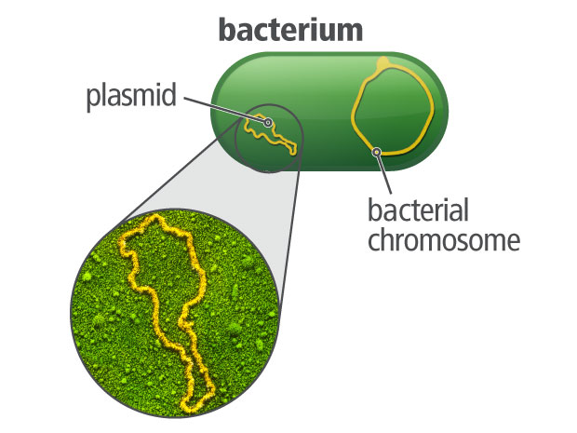
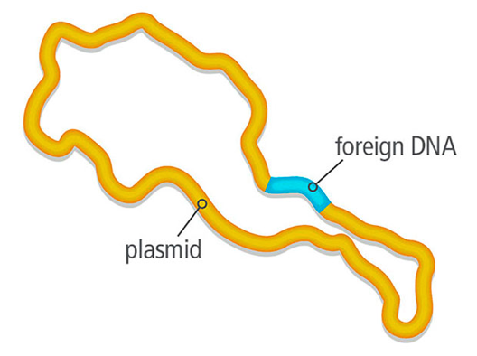
Cloning and Engineering
Unit 7 Lesson 5
Recombinant DNA technology, combining the genes from more than one organism, is a key element of genetic engineering.
In bacteria, a plasmid is a small, circular segment of DNA that is separate from the bacterial chromosome.

Slide 12

Cloning and Engineering Hands-On Activity: Modeling Genetic Engineering
Unit 7 Lesson 5
Simulate the techniques used by genetic engineers to modify genes in humans using recombinant DNA technology.

Slide 13
Cloning and Engineering
Unit 7 Lesson 5
EXPLAIN
There typically are tradeoffs when selecting a solution to a problem. Genetically engineered crops may be able to help farmers produce greater yields, but a tradeoff is the reduction in the genetic variation in crops, making crops more susceptible to disease. What other tradeoffs exist for this solution?

Slide 14
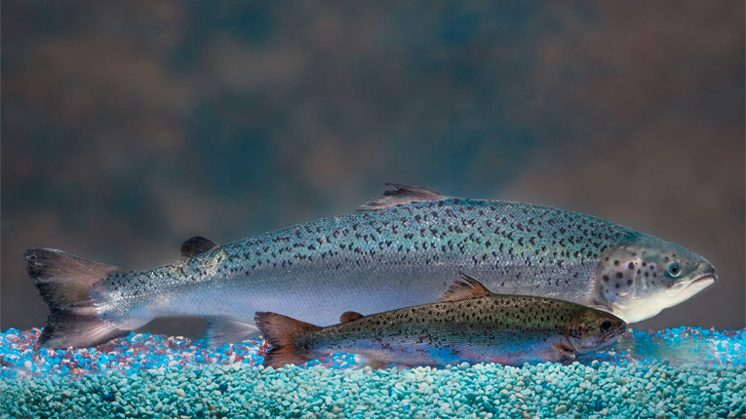
Genetically Engineering Salmon
Unit 7 Lesson 5
Farm-raised Atlantic salmon is an alternative to wild-caught fish and reduces pressure on wild populations by providing a reliable salmon source.
To solve some of the problems with farming salmon, scientists produced genetically engineered Atlantic salmon.

Slide 15
Genetically Engineering Salmon
Unit 7 Lesson 5
EXPLAIN
Design a decision matrix and use it to analyze criteria for the use of commercial fishing, normal salmon farming, and GM salmon farming in meeting the demand for salmon. Weight the criteria on a scale of 0 to 5. What is the best solution based on your criteria? Are there any problems with this solution that can be anticipated and avoided?

Slide 16
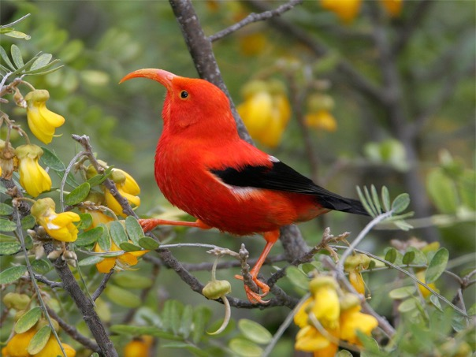
Further Applications of Genetic Engineering
Unit 7 Lesson 5
For species threatened by climate change or low genetic diversity, scientists are investigating a process known as facilitated adaptation.
Facilitated adaptation involves humans guiding adaptations in threatened populations by changing the species' genome.

Slide 17
Further Applications of Genetic Engineering Engineering
Unit 7 Lesson 5
Define a problem facing conservation. Explain what role genetic engineering could play in solving that problem. Use evidence to support your claims.

Slide 18
Further Applications of Genetic Engineering
Unit 7 Lesson 5
Gene therapy uses genetic engineering to treat or prevent the genetic basis of disease.
A common gene therapy technique uses a delivery mechanism, or vector, such as a bacterium or virus, to deliver a new gene to target cells.
Once the gene enters the cells, the new DNA is transcribed and the new protein is expressed.

Slide 19
Further Applications of Genetic Engineering
Unit 7 Lesson 5
EXPLAIN
Think back to the fluorescent zebrafish from the beginning of this lesson. Using this example, explain some implications of being able to edit genes. Where do you think science will go from here?

Slide 20
Unit 7 Lesson 5
Continue Your Exploration
Choose one of the paths below to continue your exploration:
Knockout Mice
Modeling Genetic Engineering
Labeling GMOs
Back From Extinction

Slide 21
Can You Explain It?
Unit 7 Lesson 5
Refer to the notes in your Evidence Notebook to answer the following questions:
How can a gene from one organism be inserted into the genome of an unrelated organism?
Does genetically altering an organism make a new species?
What are the implications of genetic engineering?

Slide 22
Image Credits
Unit 7 Lesson 5
zebra fish, normal light ©Ted Kinsman/Science Source; zebra fish, Ultraviolet (UV) light ©Ted Kinsman/Science Source; genetically modified, drought resistant plant ©iStock/Marccophoto/Getty Images; spider plant ©Guy Jarvis/Houghton Mifflin Harcourt; cloned dog with its father ©Handout/Handout/Getty Images News/Getty Images; Henrietta Lacks ©Science Source; bird ©Photo Resource Hawaii/Jack Jeffrey/Alamy

